Slide 1
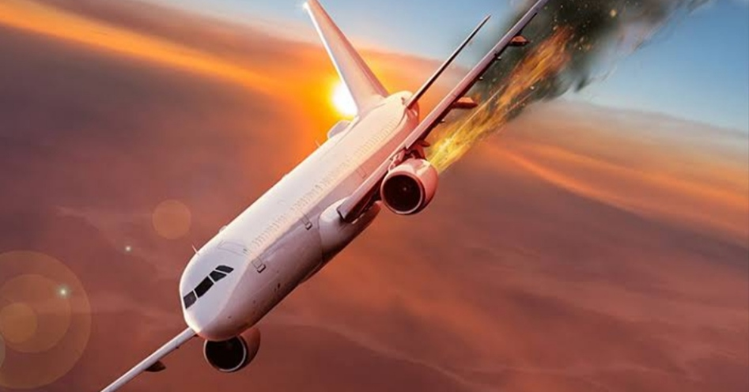
THE TRAGEDY OF FLIGHT: A comprehensive
Crash analysis.

Slide 2
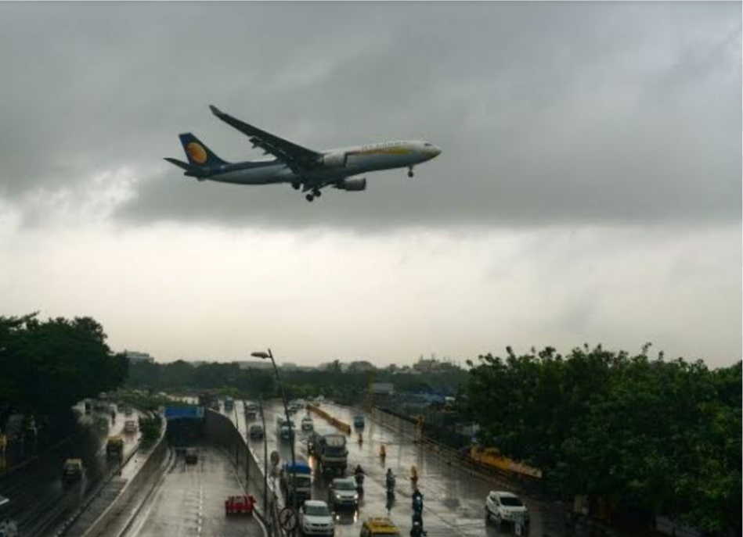
OVERVIEW
An accident in which an aircraft
hits land or water and is damaged
or destroyed.

Slide 3
CAUSES
PILOT ERROR
MECHANICAL ERROR
Pilot error is the most common cause of aviation accident.
While airline manufacture can use technology to engineer as many risks as possible out of flying , it ultimately comes down to the pilot flying the aircraft to execute a takeoff and landing.
Mechanical error are the second leading cause of aviation accident according for 22% of all crashes.
Mechanical errors could occur because of a flaw inherent in the aircraft design or because a mechanical part was not properly installed.

Slide 4
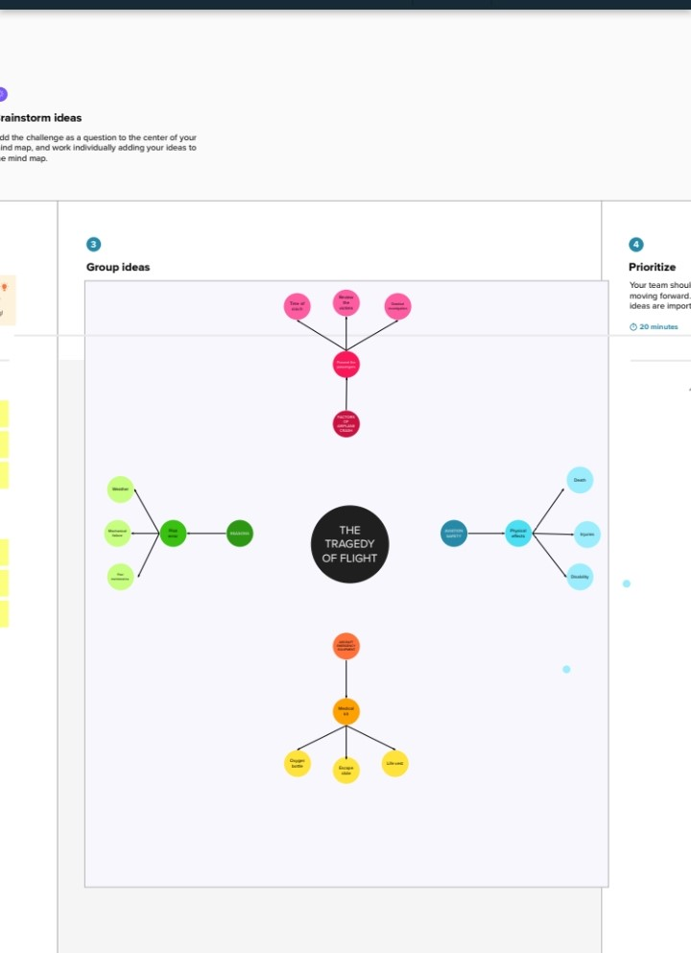
DESIGN THINKING

Slide 5
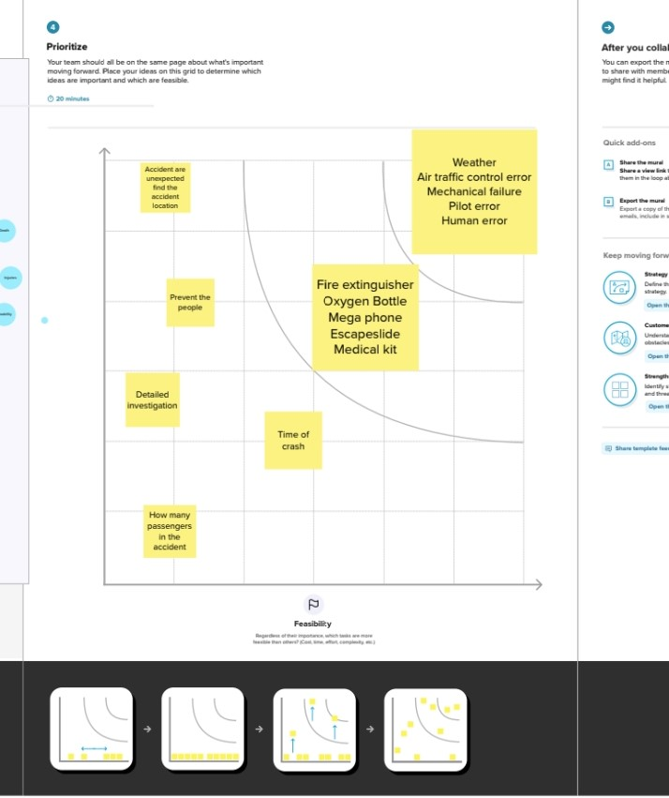
GRAPHICAL PRESENTATION

Slide 6
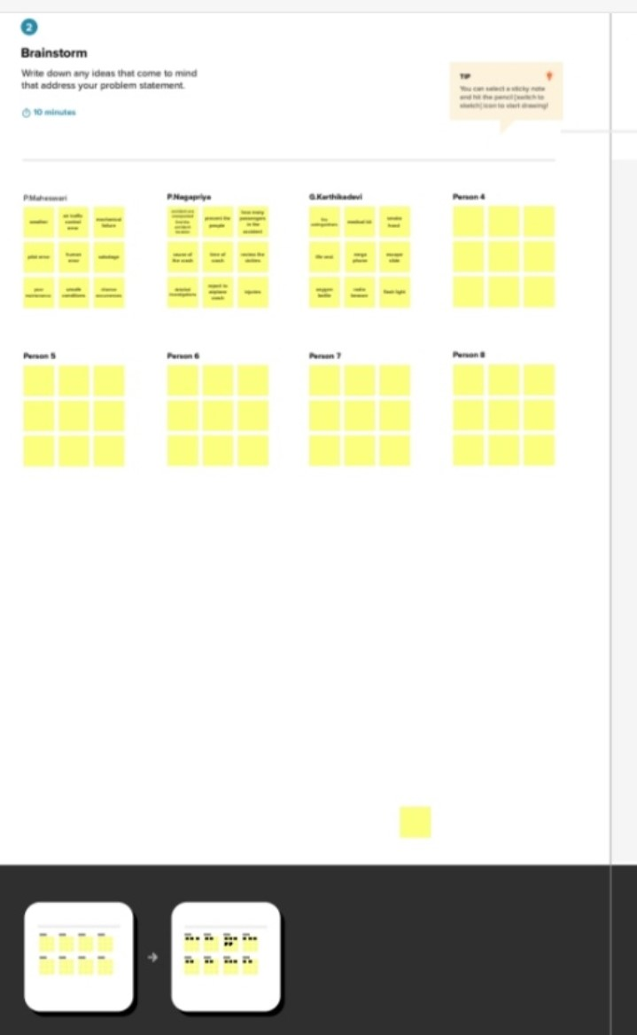
BRAINSTORMING IDEAS

Slide 7
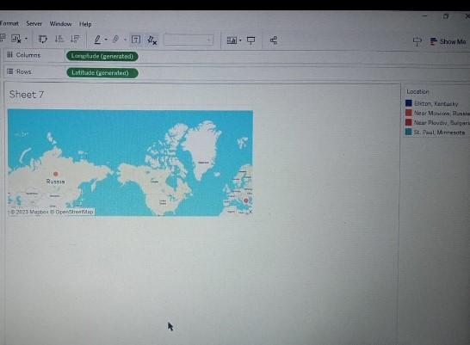
DASH BOARD

Slide 8
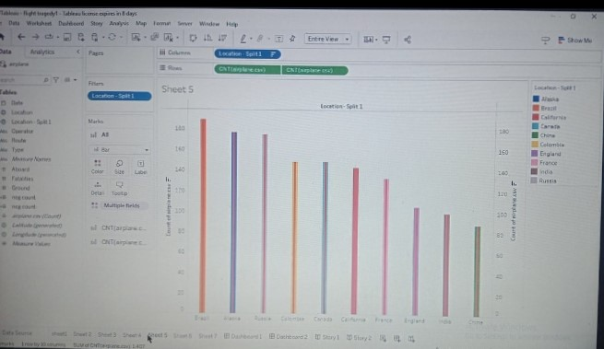

Slide 9
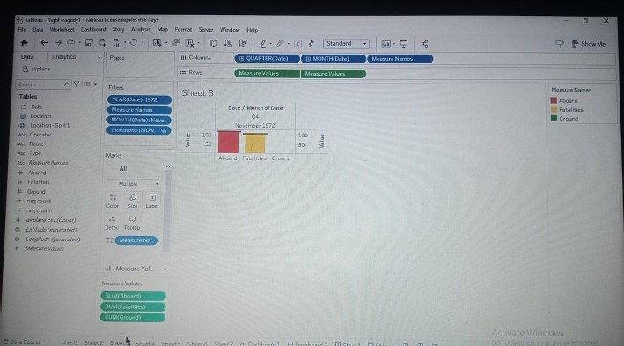

Slide 10
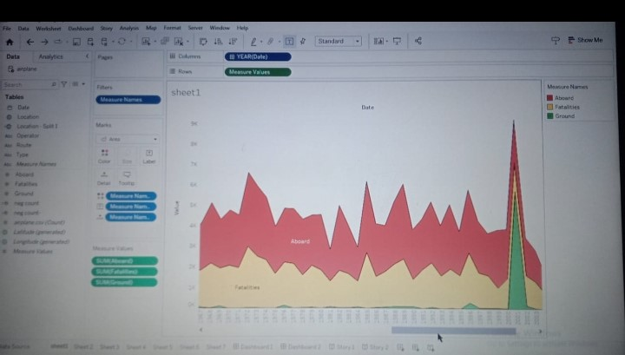
DASH BOARD 2

Slide 12
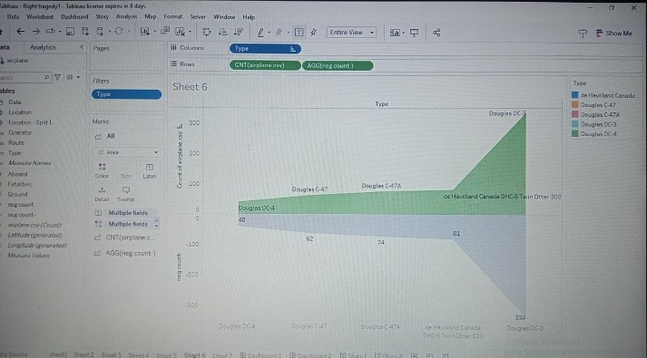

Slide 13
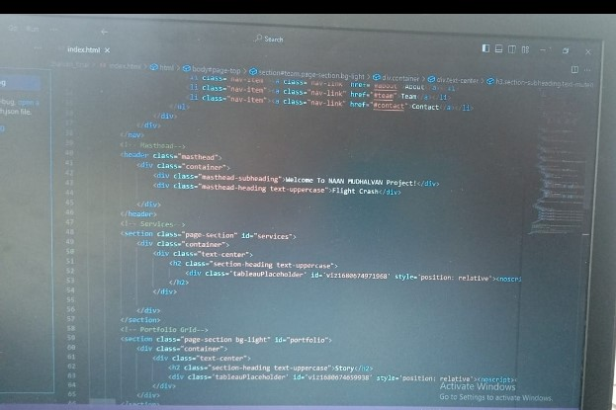
SOURCE BOARD

Slide 14
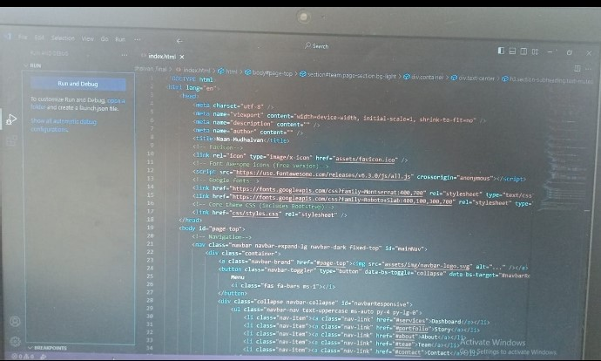

Slide 15
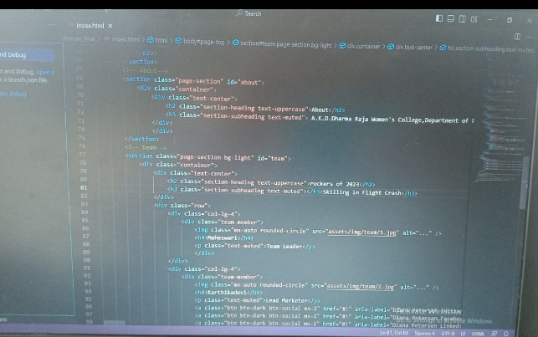

Slide 16
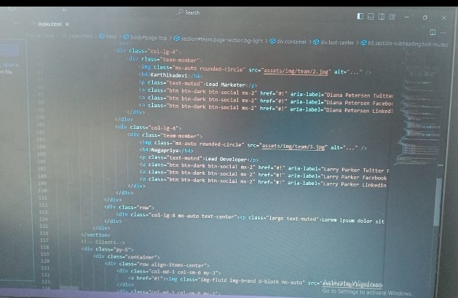

Slide 17
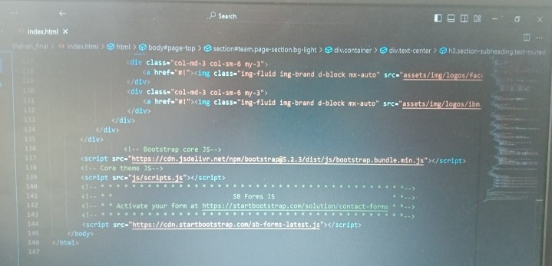

Slide 18
PROBLEM
TRAGEDY OF FLIGHT PROBLEM:
● PILOT ERRORS,
● MECHANICAL FAULTS,
● INCLEMENT WEATHER .

Slide 19
SUMMARY
→ Air line manufacture can use technology to engineer as many risks as possible out of flying , it ultimately comes down to the pilot flying the air craft to execute a take off and landing.
→ Mechanical errors could occur because of a flaw inherent in the air craft design or because a mechanical part was not properly installed.

Slide 20
TEAM LEADER : P . Maheswari.
TEAM MEMBER : G . Karthikadevi,
TEAM MEMBER : P . Nagapriya.

